Slide 1
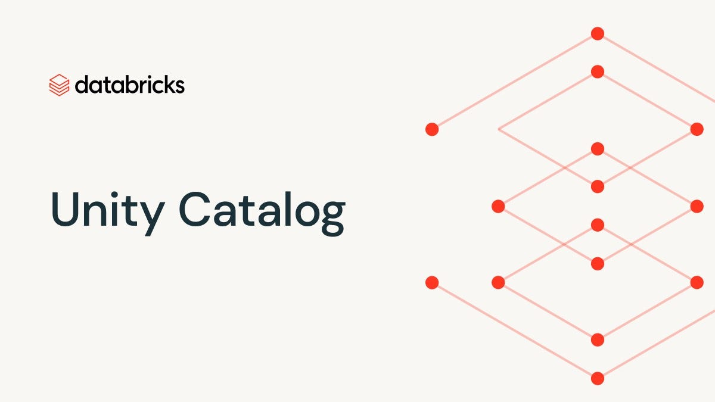

Slide 2
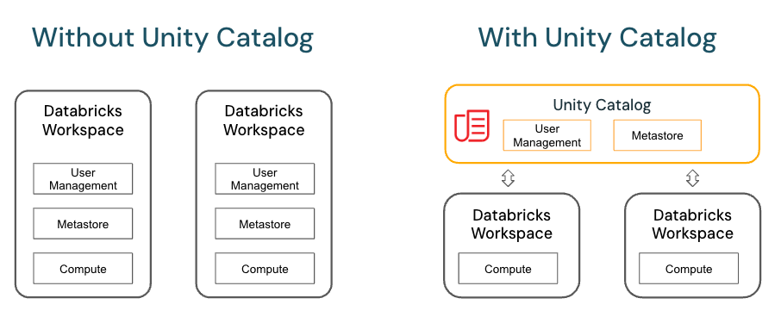
Unity Catalog is a feature within Azure Databricks that offers a unified governance solution for all data and AI assets.
Unity Catalog provides a centralized metastore that manages data objects across all workspaces in an organization.
Centralized Layer: Unity Catalog is introduced as a centralized layer that includes user management and the metastore.
Shared Resources: Multiple Databricks Workspaces share the centralized user management and metastore provided by Unity Catalog.
Compute: Each workspace still maintains its own compute component, but user management and metadata are now centralized and shared across workspaces.
Benefits of Unity Catalog:
Simplified Administration: Centralized user management and metadata simplify the administration process.
Improved Consistency: Ensures consistent user and metadata management across multiple workspaces, reducing redundancy and potential errors.

Slide 3
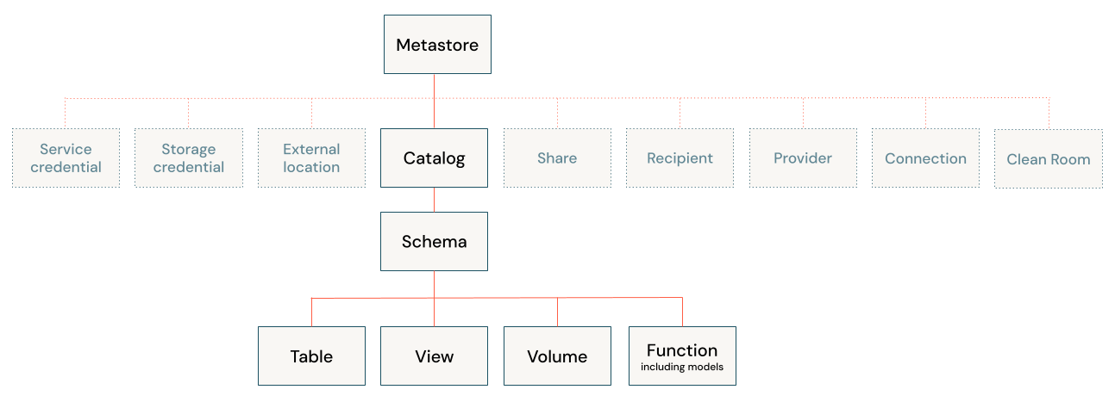
Unity Catalog Object Model

Slide 4
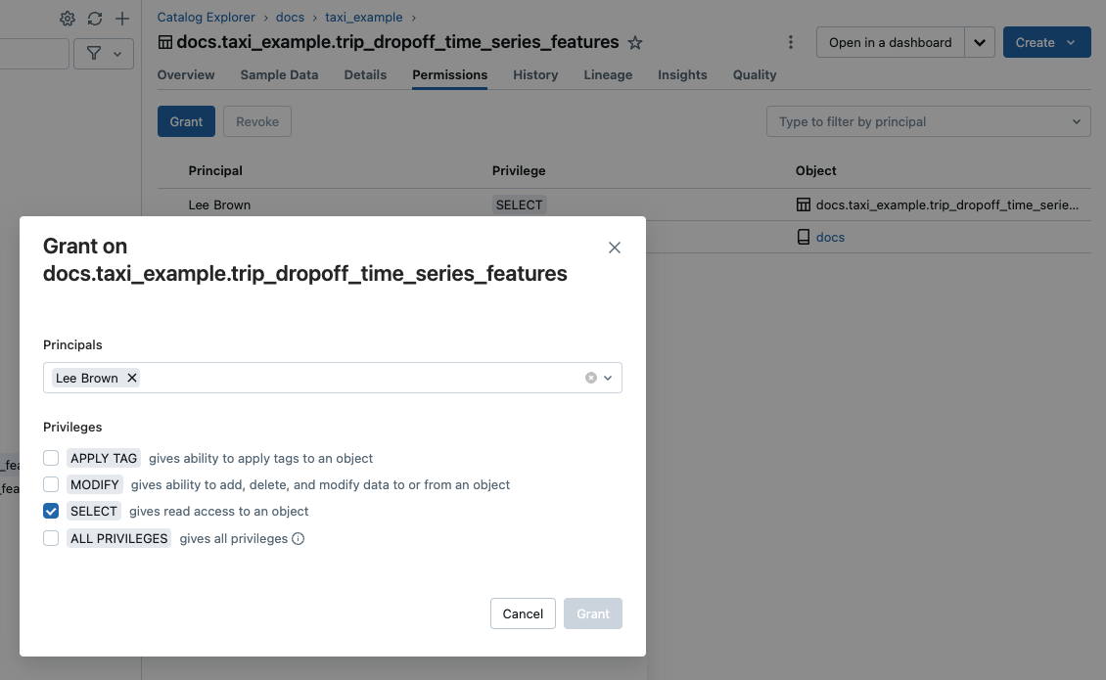

Slide 5
Microsoft Purview | Databricks Unity Catalog
Ecosystem: Primarily designed for the Azure ecosystem, including Azure Synapse Analytics, SQL Server, Power BI, and more. Features: Offers data discovery, lineage tracking, data classification, unified data maps, and access controls. Use Cases: Ideal for organizations looking to manage and govern data across various environments, including on-premises, multi-cloud, and SaaS applications | Ecosystem: Tailored for the Databricks ecosystem, providing a cloud-agnostic approach to data lake governance. Features: Includes data search and discovery, automated lineage, granular access controls, AI-powered monitoring, and open data sharing. Use Cases: Best suited for managing data and AI workloads within the Databricks Lakehouse platform
Purview is a comprehensive solution for broader data governance across multiple platforms ( saas / paas /Multi cloud), while Unity Catalog focuses on governance within the Databricks environment

Slide 6
Key Features of Unity Catalog
Unified Namespace: Unity Catalog offers a single namespace for datasets, files, and machine learning models across all workspaces, making it easier to manage and discover assets.
Fine-grained Access Control: It allows administrators to set precise access controls on data using standard SQL GRANT and REVOKE statements, aligning with the principle of least privilege.
Data Lineage: Unity Catalog captures and displays data lineage, which is critical for tracking the flow of data and understanding its transformations over time.
Centralized Metadata Management: Manages all metadata centrally, ensuring that definitions, descriptions, and other metadata are consistent across projects and workspaces.
Integration with Databricks SQL: Unity Catalog is fully integrated with Databricks SQL, allowing for seamless querying and management of data assets without moving data out of the platform.

